Slide 1

Customer Lifetime Value
Detailed Project Report
Ra
by Rushikesh Khandare

Slide 2

Project Details:
Project Title
Customer Lifetime Value
Business intelligence
Technology
Domain
Banking Insurance
and Finance
Difficulty Level
Advanced

Slide 3

Analyzing Google Apps Store Dataset
1
Objective
The objective involves applying various business intelligence tools such as Tableau or Power BI to understand insights from the data effectively.
2
Problem Statement
It is used as a collective term to refer to a broad range of economic services provided by the finance industry, which encompasses a broad range of organizations that manage money, including credit unions, banks, credit card companies, insurance companies, consumer finance companies, stock brokerages, investment funds.

Slide 4

Insight Generation
1
Technological Dominance
2
Data Mining
Predict the customer life-time value for an Auto Insurance Company. Its revenue will increase if the amount claimed by customers who have insured in the company is low.
Utilizing data mining techniques, critical metrics and factors can be extracted from vast datasets, enabling the discernment of meaningful relationships between attributes.

Slide 5

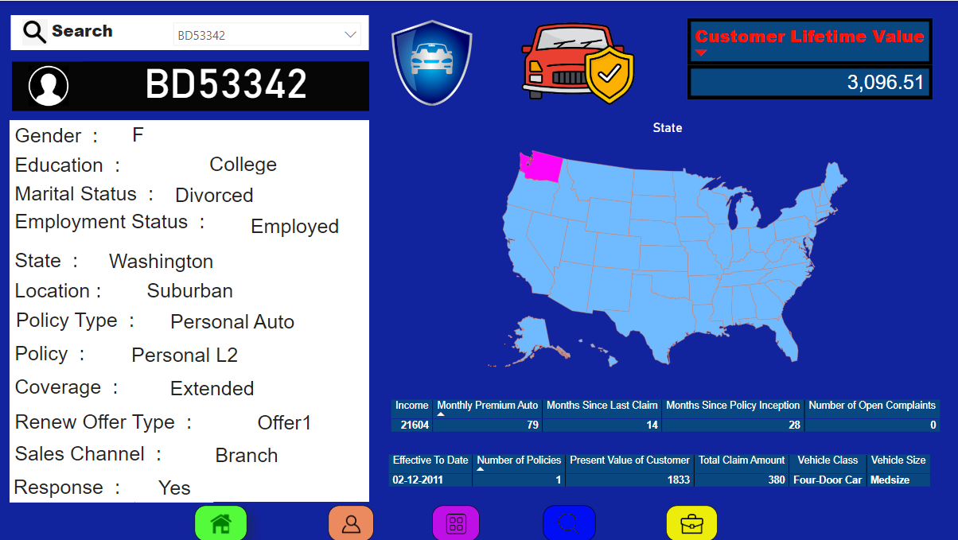
Dataset Analysis Approach
Tools Utilization
Visual Understanding
Utilizing tools like Tableau or Power BI to visualize data and gain deep insights.
Visualizing data using modern technology to gain a clear understanding of trends and patterns.

Slide 6



Data Mining Results
Data Extraction
Insightful Relationships
Trend Analysis
Extracted significant insights through data mining techniques.
Analyzed trends within the dataset to gain valuable insights.
Identified meaningful relationships between various attributes.

Slide 7
Data Visualization Tools
1
2
Data Representation
Insightful Insights
Visualized data to represent the unique attributes and metrics within the dataset.
Provided deep insights into the dataset through effective visualization techniques.

Slide 8

Enhancing Technological Insights
Interactive Visualization
Data-Driven Decision Making
Implementing interactive visualization methodologies to gain an in-depth understanding of technology trends.
Utilizing data-driven visual insights to make informed decisions within the technology domain.

Slide 9
Technology Integration
Integration of Technology
Utilized modern technology integration for comprehensive data analysis.
Data-Driven Approach
Applied a data-driven approach to technology analysis for robust insights.

Slide 10
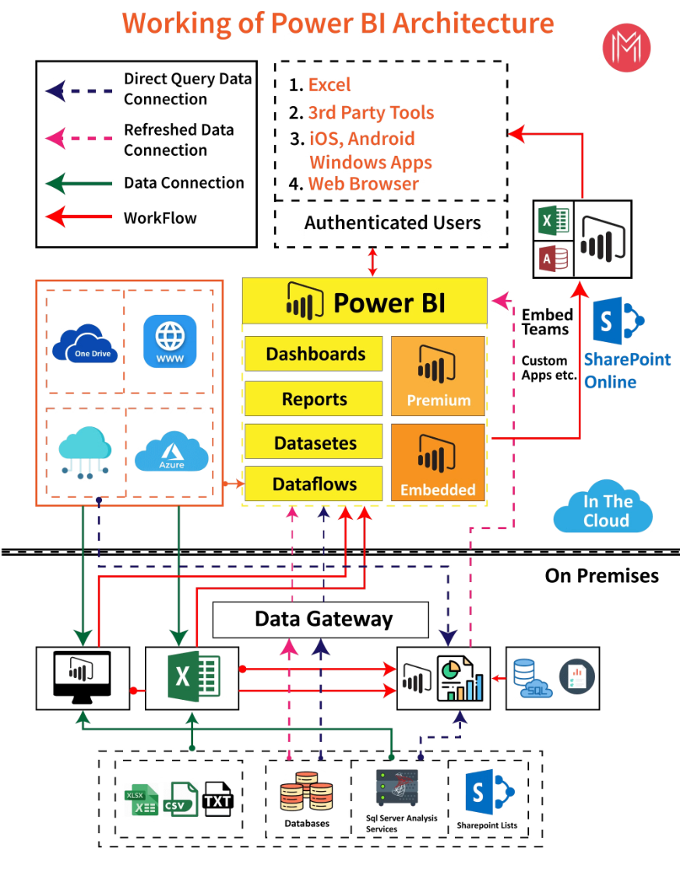
Architecture

Slide 11
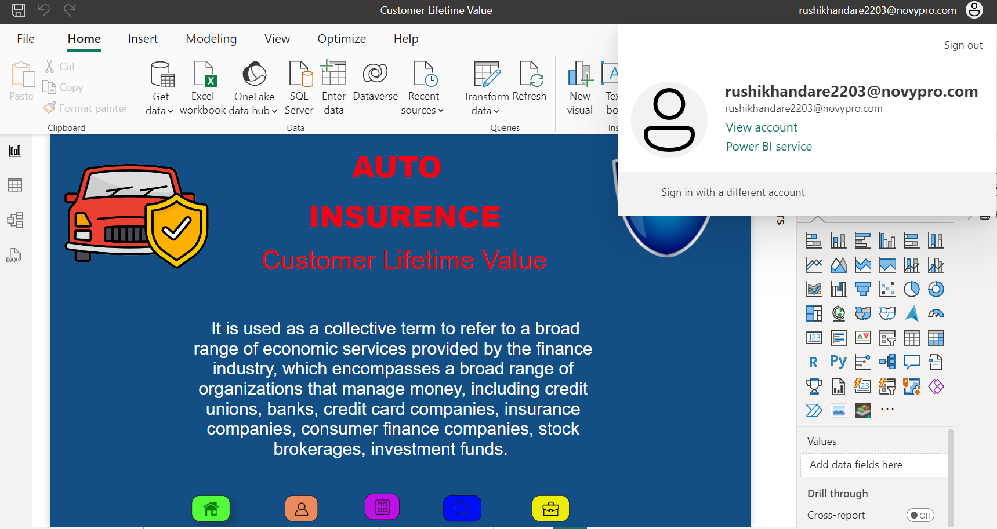
Insights
Login

Slide 12
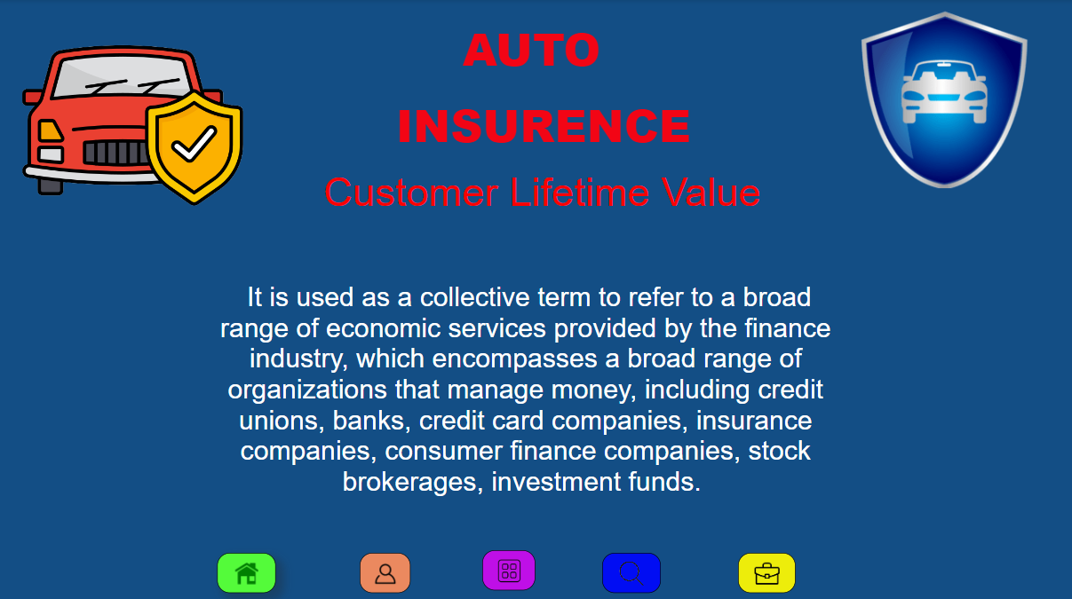
Insights
Home

Slide 13
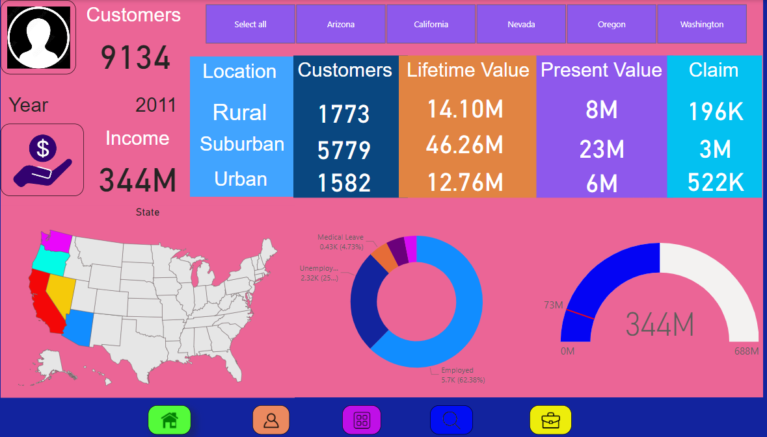
Insights
Customers

Slide 14
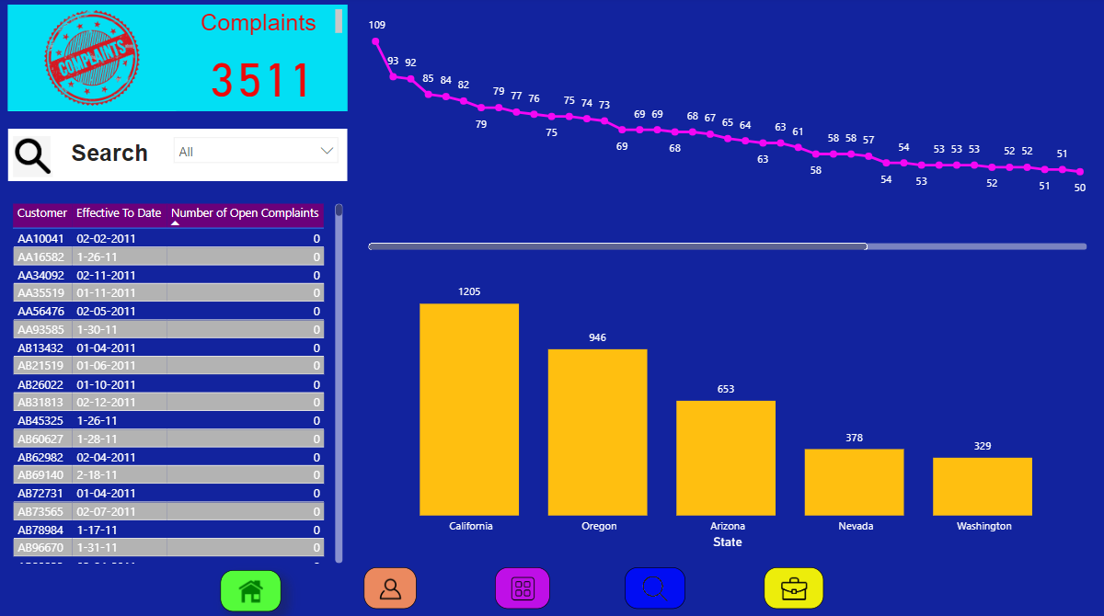
Insights
Complaints

Slide 15
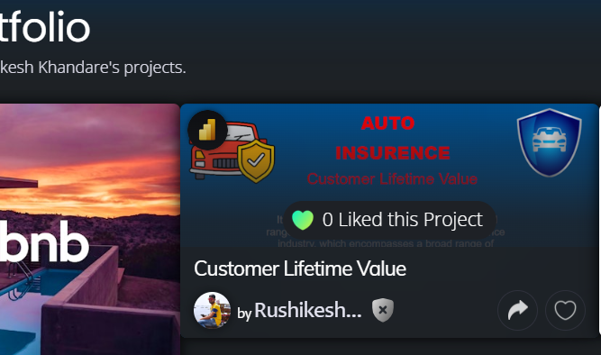
NovyPro Dashboard

Slide 16
QUESTIONS
Q1) What’s the source of data?
The dataset is taken from ineuron
Q2) What was the type of data?
The data was the combination of numerical and Categorical values.
Q 3) What techniques were you using for data pre-processing?
Removing unwanted attributes
Visualizing relation of independent variables with each other and output variables
Checking and changing Distribution of continuous values
Removing outliers
Cleaning data and imputing if null values are present.

Slide 17

Thank you

